Slide 1

Telescope Autofocuser
Albin Myscich
Alonna Too-Chiobi
Camille Watson
Joseph Basdeo
Sponsor: Dr. Kevin Nowka
TA: Swarnabha Roy

Slide 2
Problem Summary
Problem Statement:
Telescope focusing & image processing automation
The Telescope Autofocuser Will:
Stream current images to dev board using an imager
Autofocus using a stepper motor interface
Display focused image post processing through a GUI
https://www.highpointscientific.com/apertura-6inch-f5-newtonian-ota-6f5n
Notes:
Quick reminder on what our project is about:
We are developing a device that provides users the ability to automatically focus their telescope as well as obtain a high quality image of their object of interest.
We have multiple motivations for this project, the main one being that it reduces the learning curve for beginner hobbyist, which in turn results in growth of the astronomy community.

Slide 3
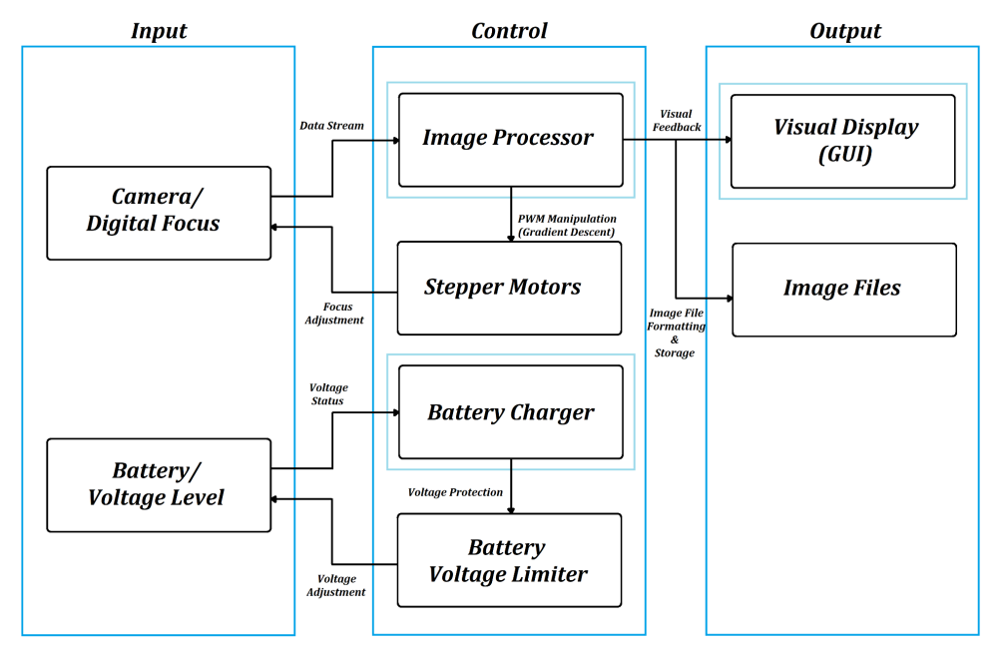
Project Design
Notes:
Here is a refresher on how the different subsystems relate to each other. Nothing has changed since our first presentation. The camera is still communicating with the image processor who is talking to the GUI, image files, and stepper motors; and the battery is still communicating with the charger who is communicating with the voltage limiter who is then talking back to the battery.

Slide 4
Task Partition
Albin Myscich | Image Post-processing Real-time Sub-system Software Modulation & Validation Focuser Automation 3D Modeling, Design, & Validation
Alonna Too-Chiobi | Motor & Mounting Assembly
Camille Watson | Power Interfacing & Redundancy
Joseph Basdeo | Imager & Mounting Assembly
Notes:
Task partitions have remained the same

Slide 5
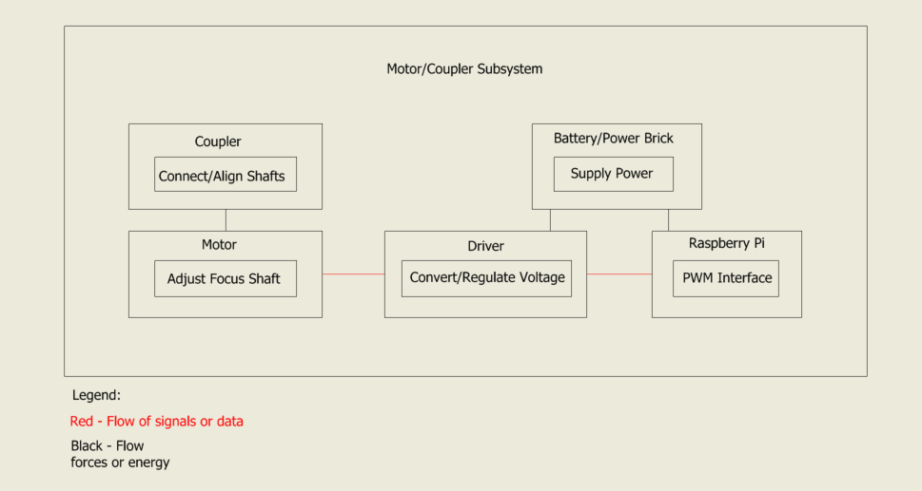
Stepper Motor & Coupler Subsystem Overview
Stepper Motor:
Adjusts focusing shaft depending on positional input
Motor Coupler:
Connect and align motor arm to focusing shaft
Smoothly transfer torque

Slide 6
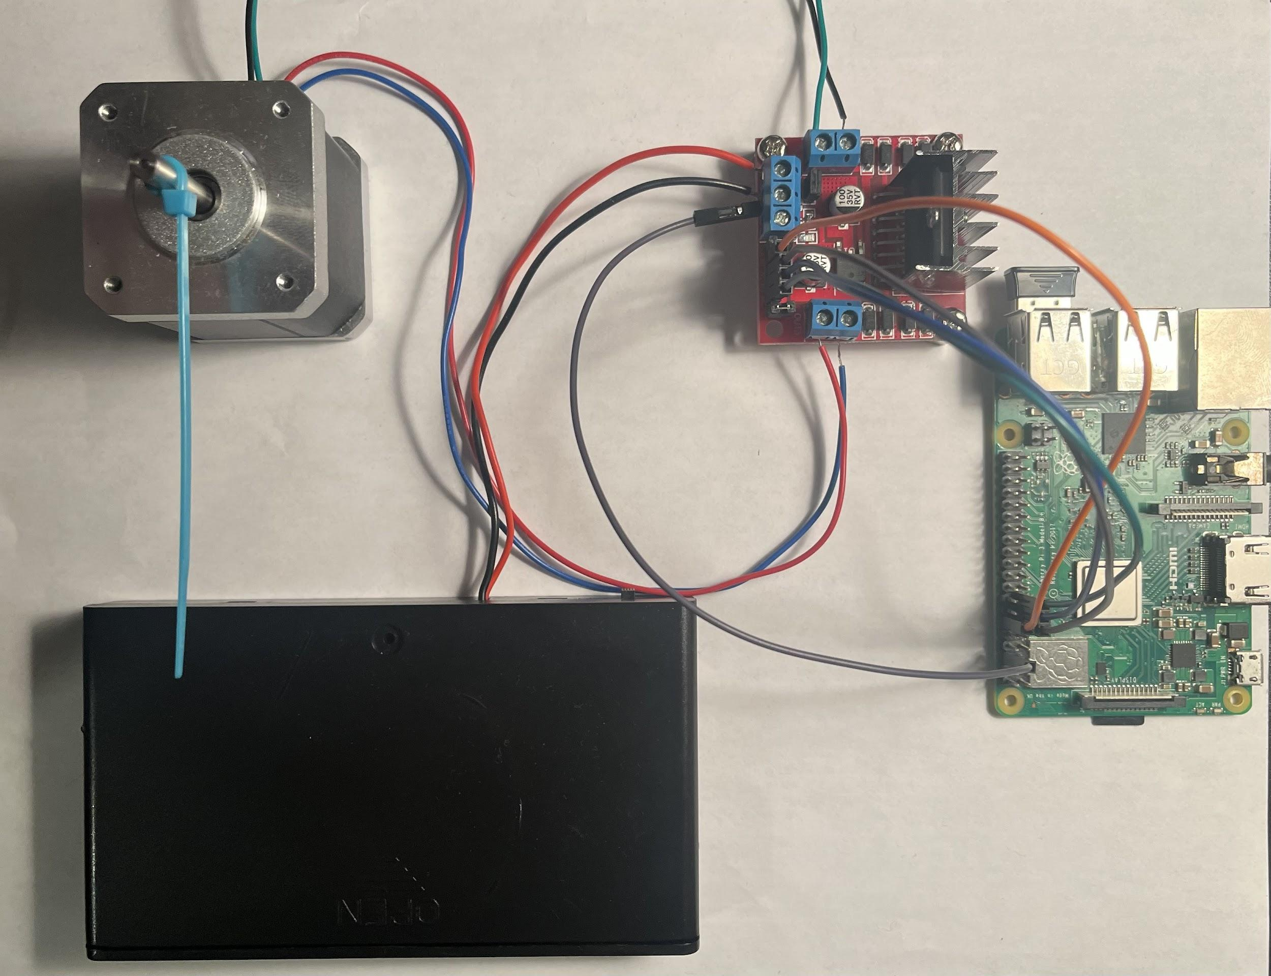
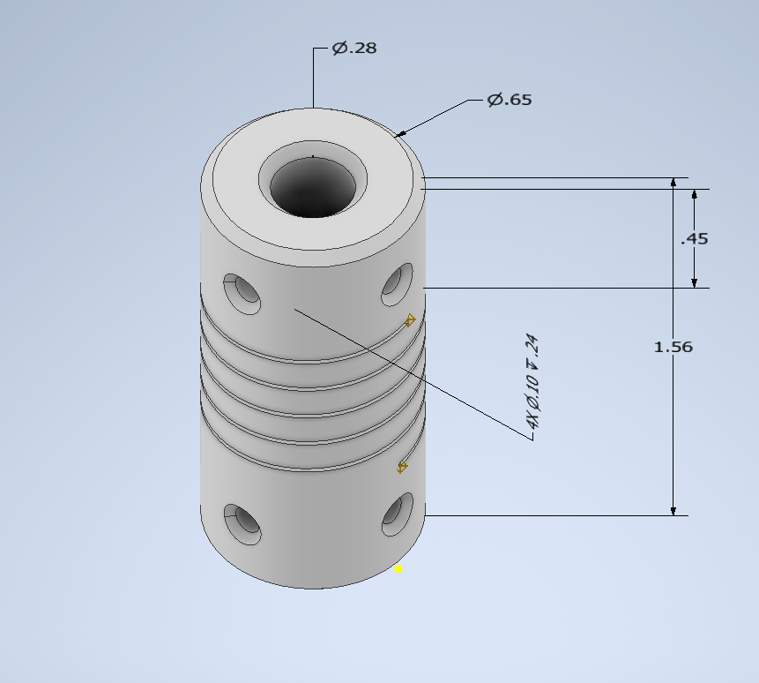
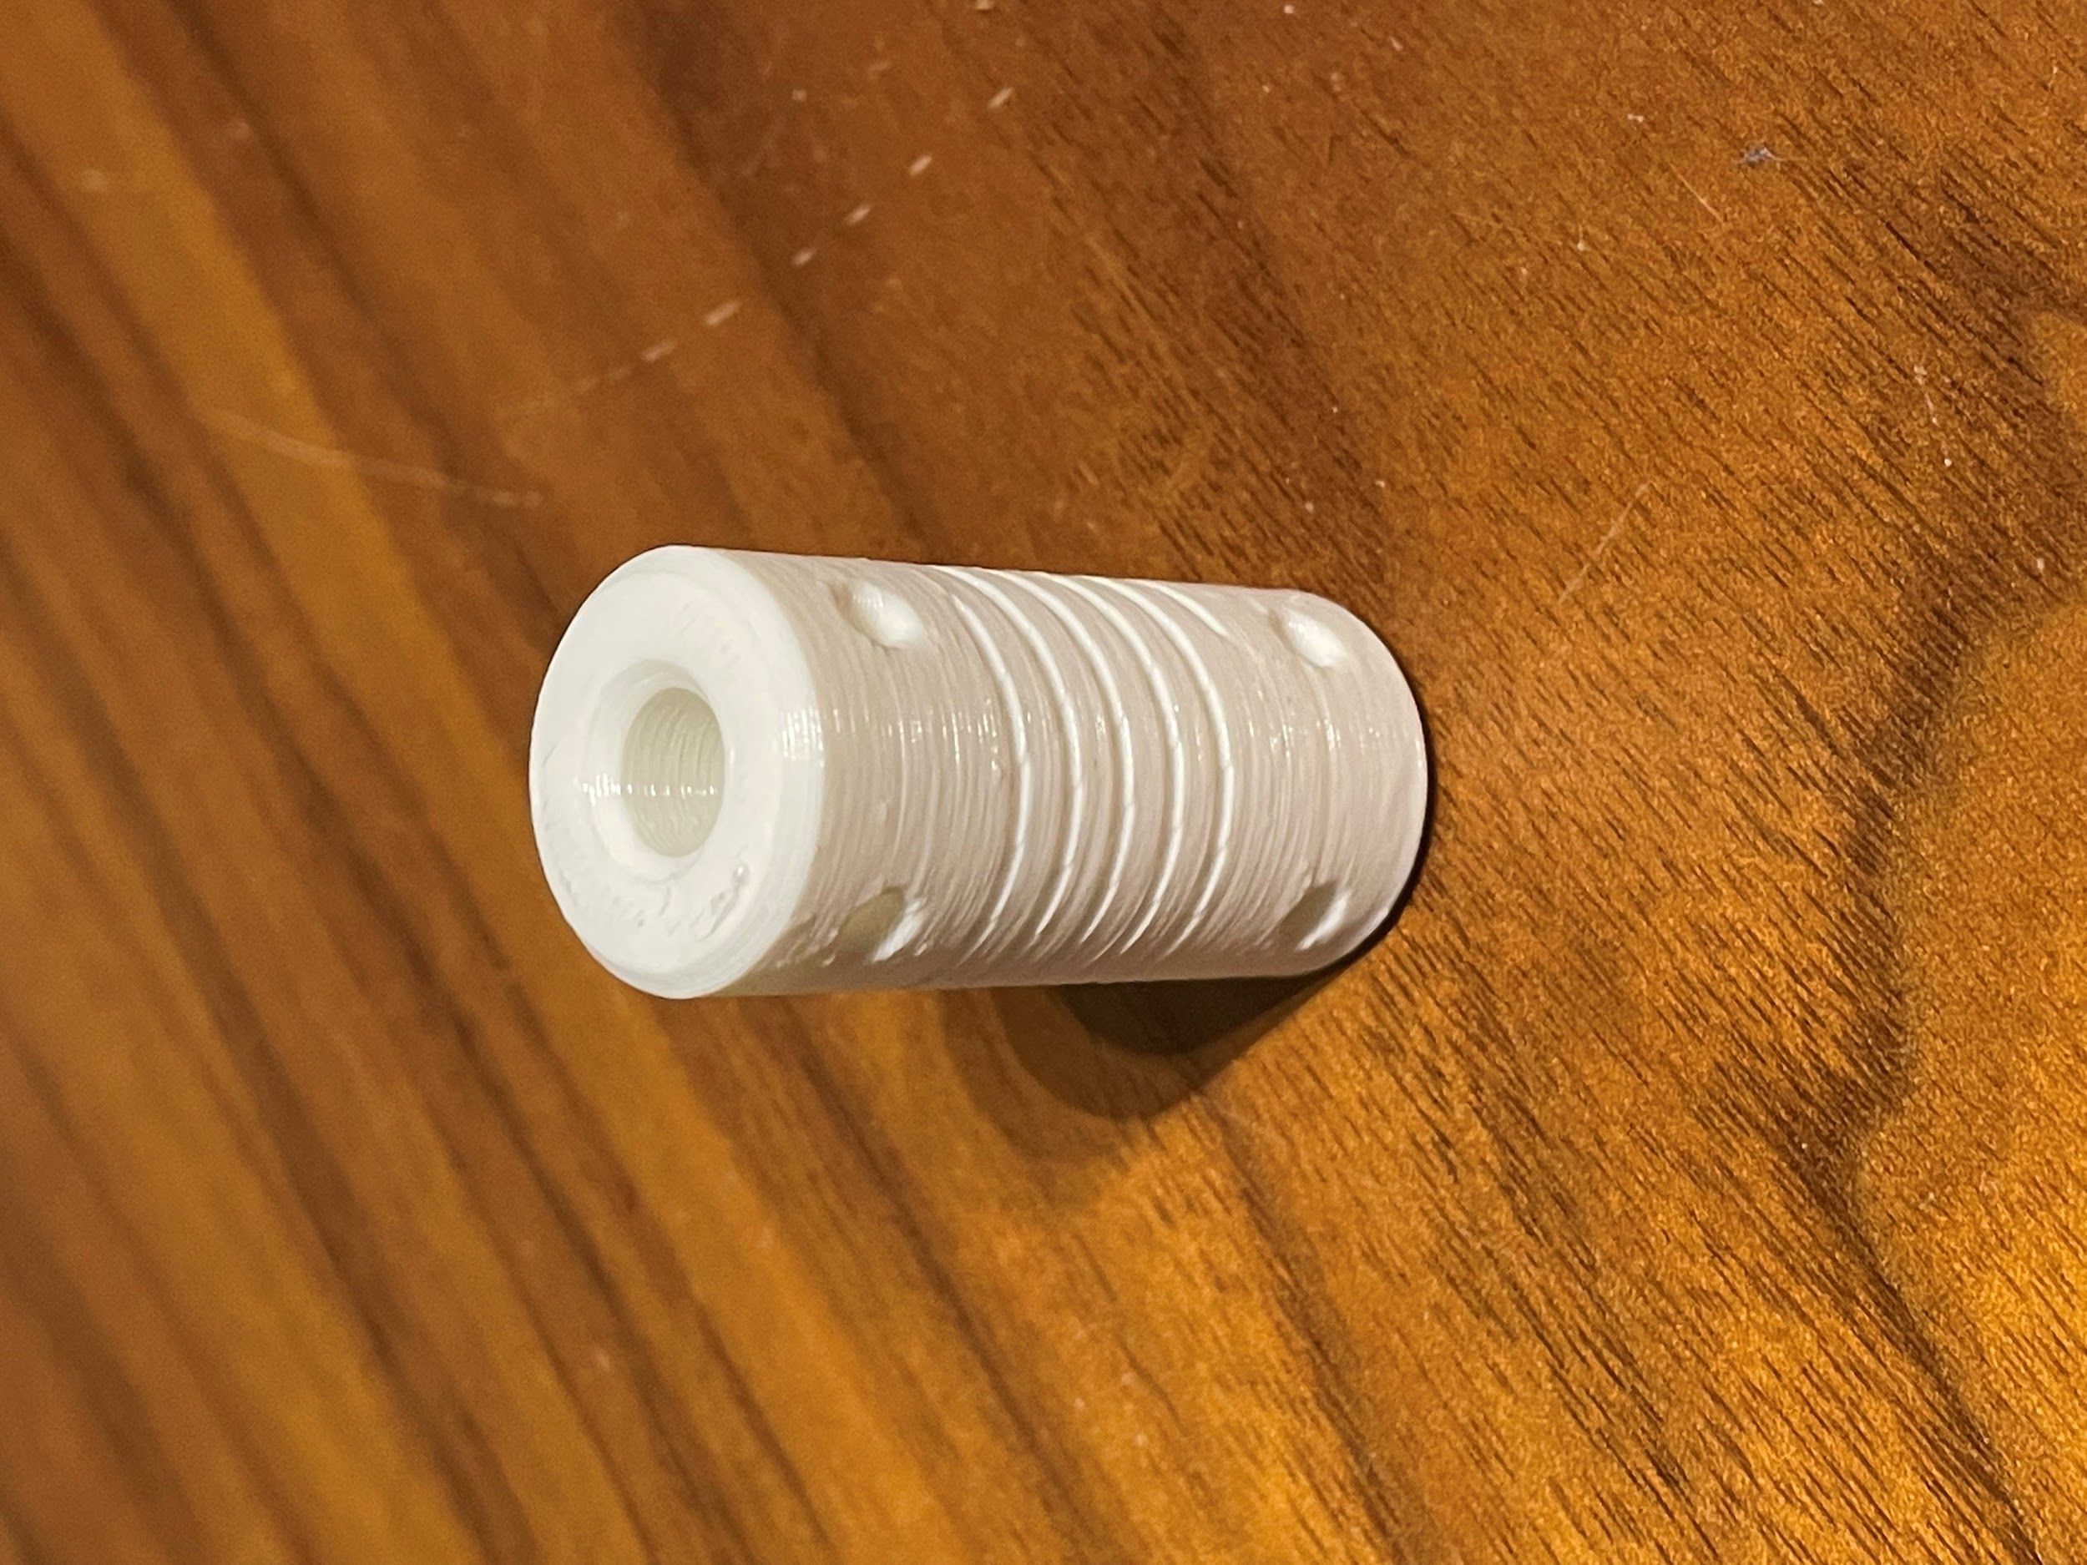
Stepper Motor & Coupler Subsystem Accomplishments
Stepper Motor:
Does motor operate on specific positions?
Does motor operate without damaging the motor mount and assembly subsystem?
Motor Coupler:
Do dimensions operate within the constraints of the telescope?
Are parts the same dimensions as designed?
Notes:
Stepper Motor:
…
Yes
The motor rotates at a constant speed and moves depending on positional input
The original step angle is .9 degrees which equates to 400 steps for a full 360 degree rotation.
In order to achieve more precise angular positioning of the shaft I incorporated the technique called “Half-Stepping” in my script. This is a technique where instead of powering 1 phase at a time, we will power a combination of 1 or 2 phases bringing the step angle down to .45 degrees and improving the precision.
Mention improvements
…
In progress
Due to setbacks with a previous coupler design, we just finished printing the new coupler and plan on testing operation today.
Motor Coupler:
…
Yes
Discuss dimensions
Discuss design specs (degree of misalignment, torque loss, etc)
By including a helical cut in the model, this gives the design flexibility which helps to compensate for misalignment and movement between shafts. This compensation is crucial because perfect alignment of two shafts is extremely difficult and rarely achieved. The better the alignment, the smoother/better the torque/power transfer is between the two shafts.
…
Yes
To account for shrinkage a tenth of an inch was added to the models dimensions. 3D printing is complete and the product is within the expected error range (+/- .01 inch). After testing the fit of the coupler we will determine if we want to reprint or keep the current design.

Slide 7
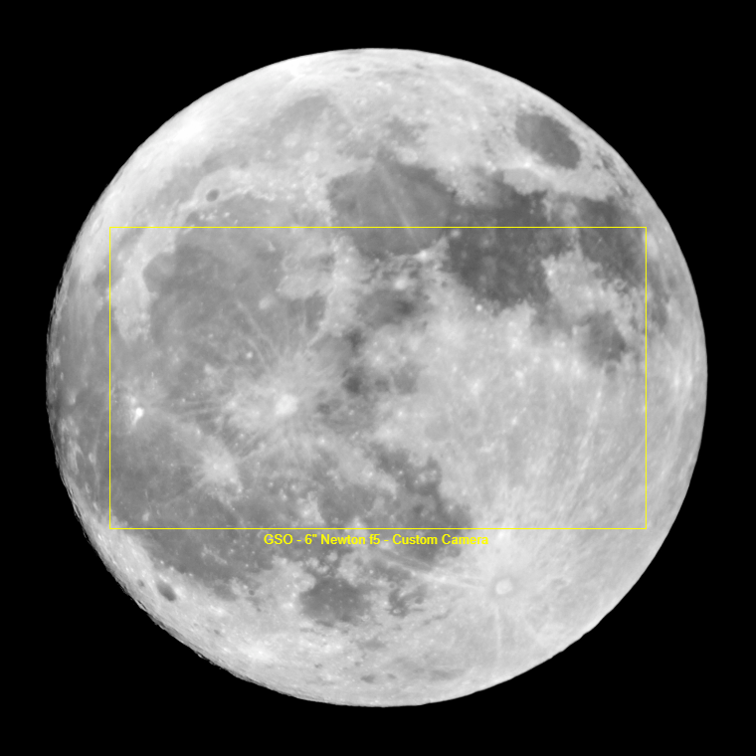
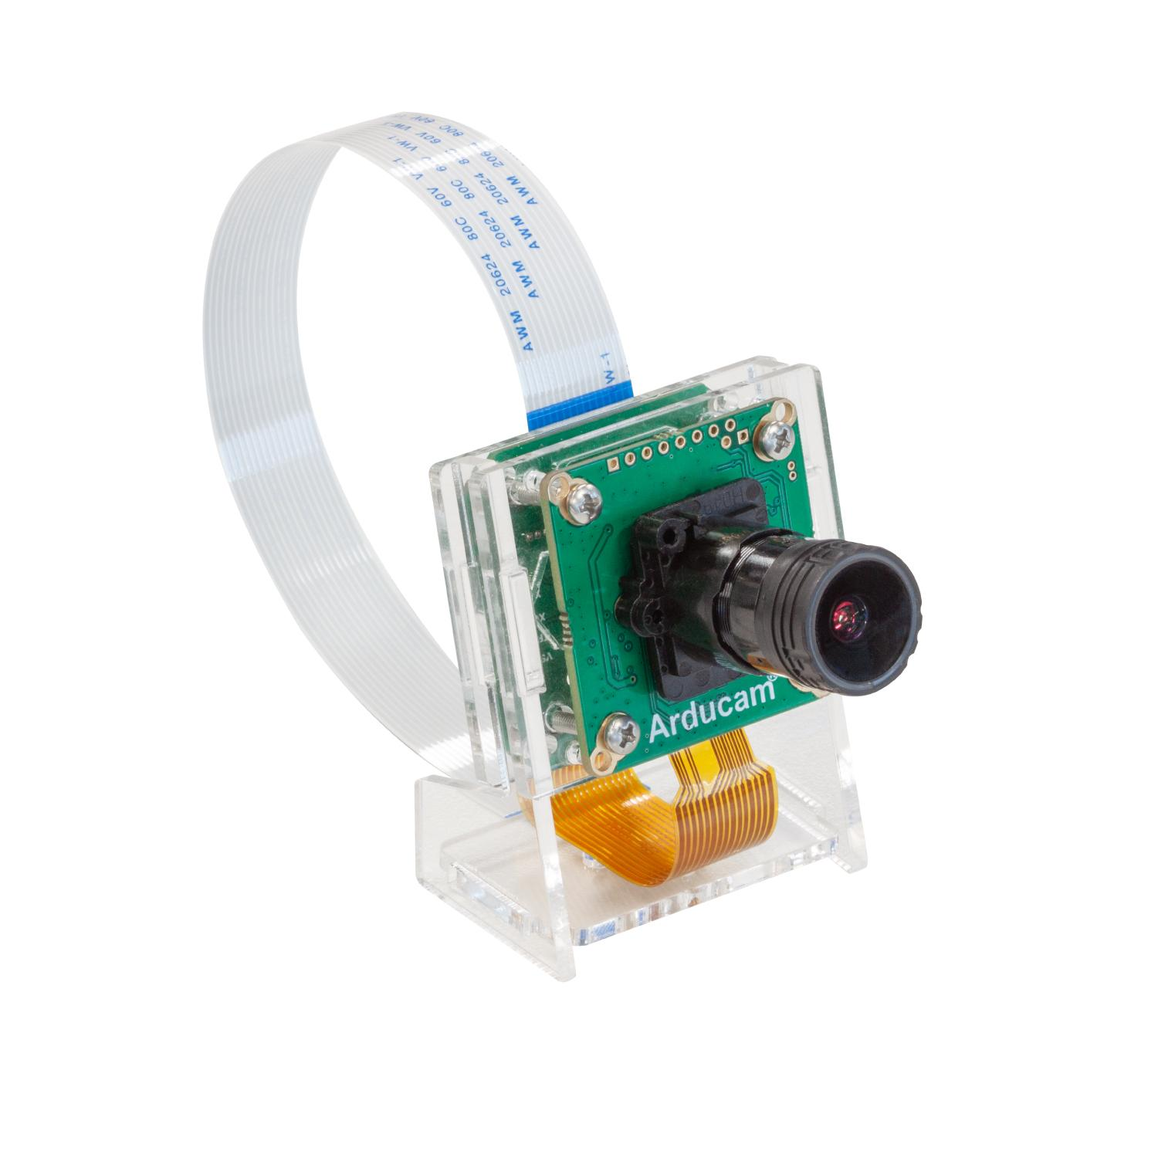
Imager Overview
View and capture images
Stream data to Raspberry Pi
Interface to lens
Specifications
Resolution: 1920x1080 pixels
Pixel Size: 2.9x2.9 μm
Simulated image capture of moon
Notes:
Simulation source: astronomy.tools/calculators/field_of_view
Camera image source: https://www.arducam.com/product/arducam-for-raspberry-pi-ultra-low-light-camera-1080p-hd-wide-angle-pivariety-camera-module-based-on-1-2-7inch-2mp-starvis-sensor-imx462-compatible-with-raspberry-pi-isp-and-gstreamer-plugin/

Slide 8
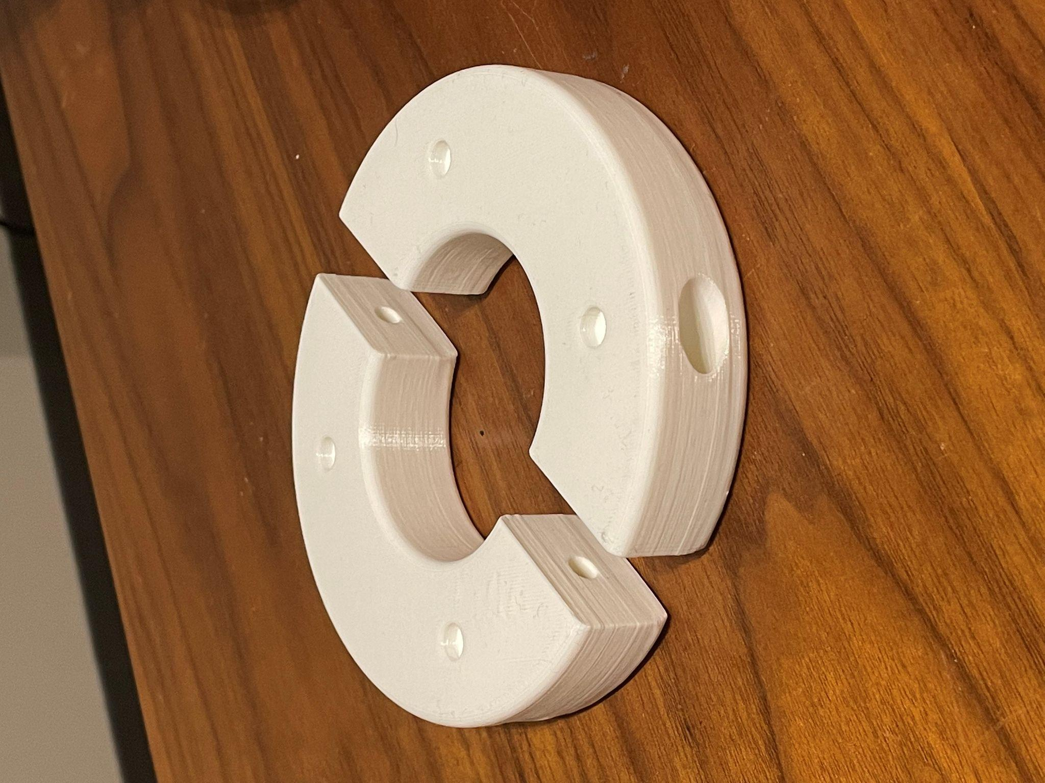
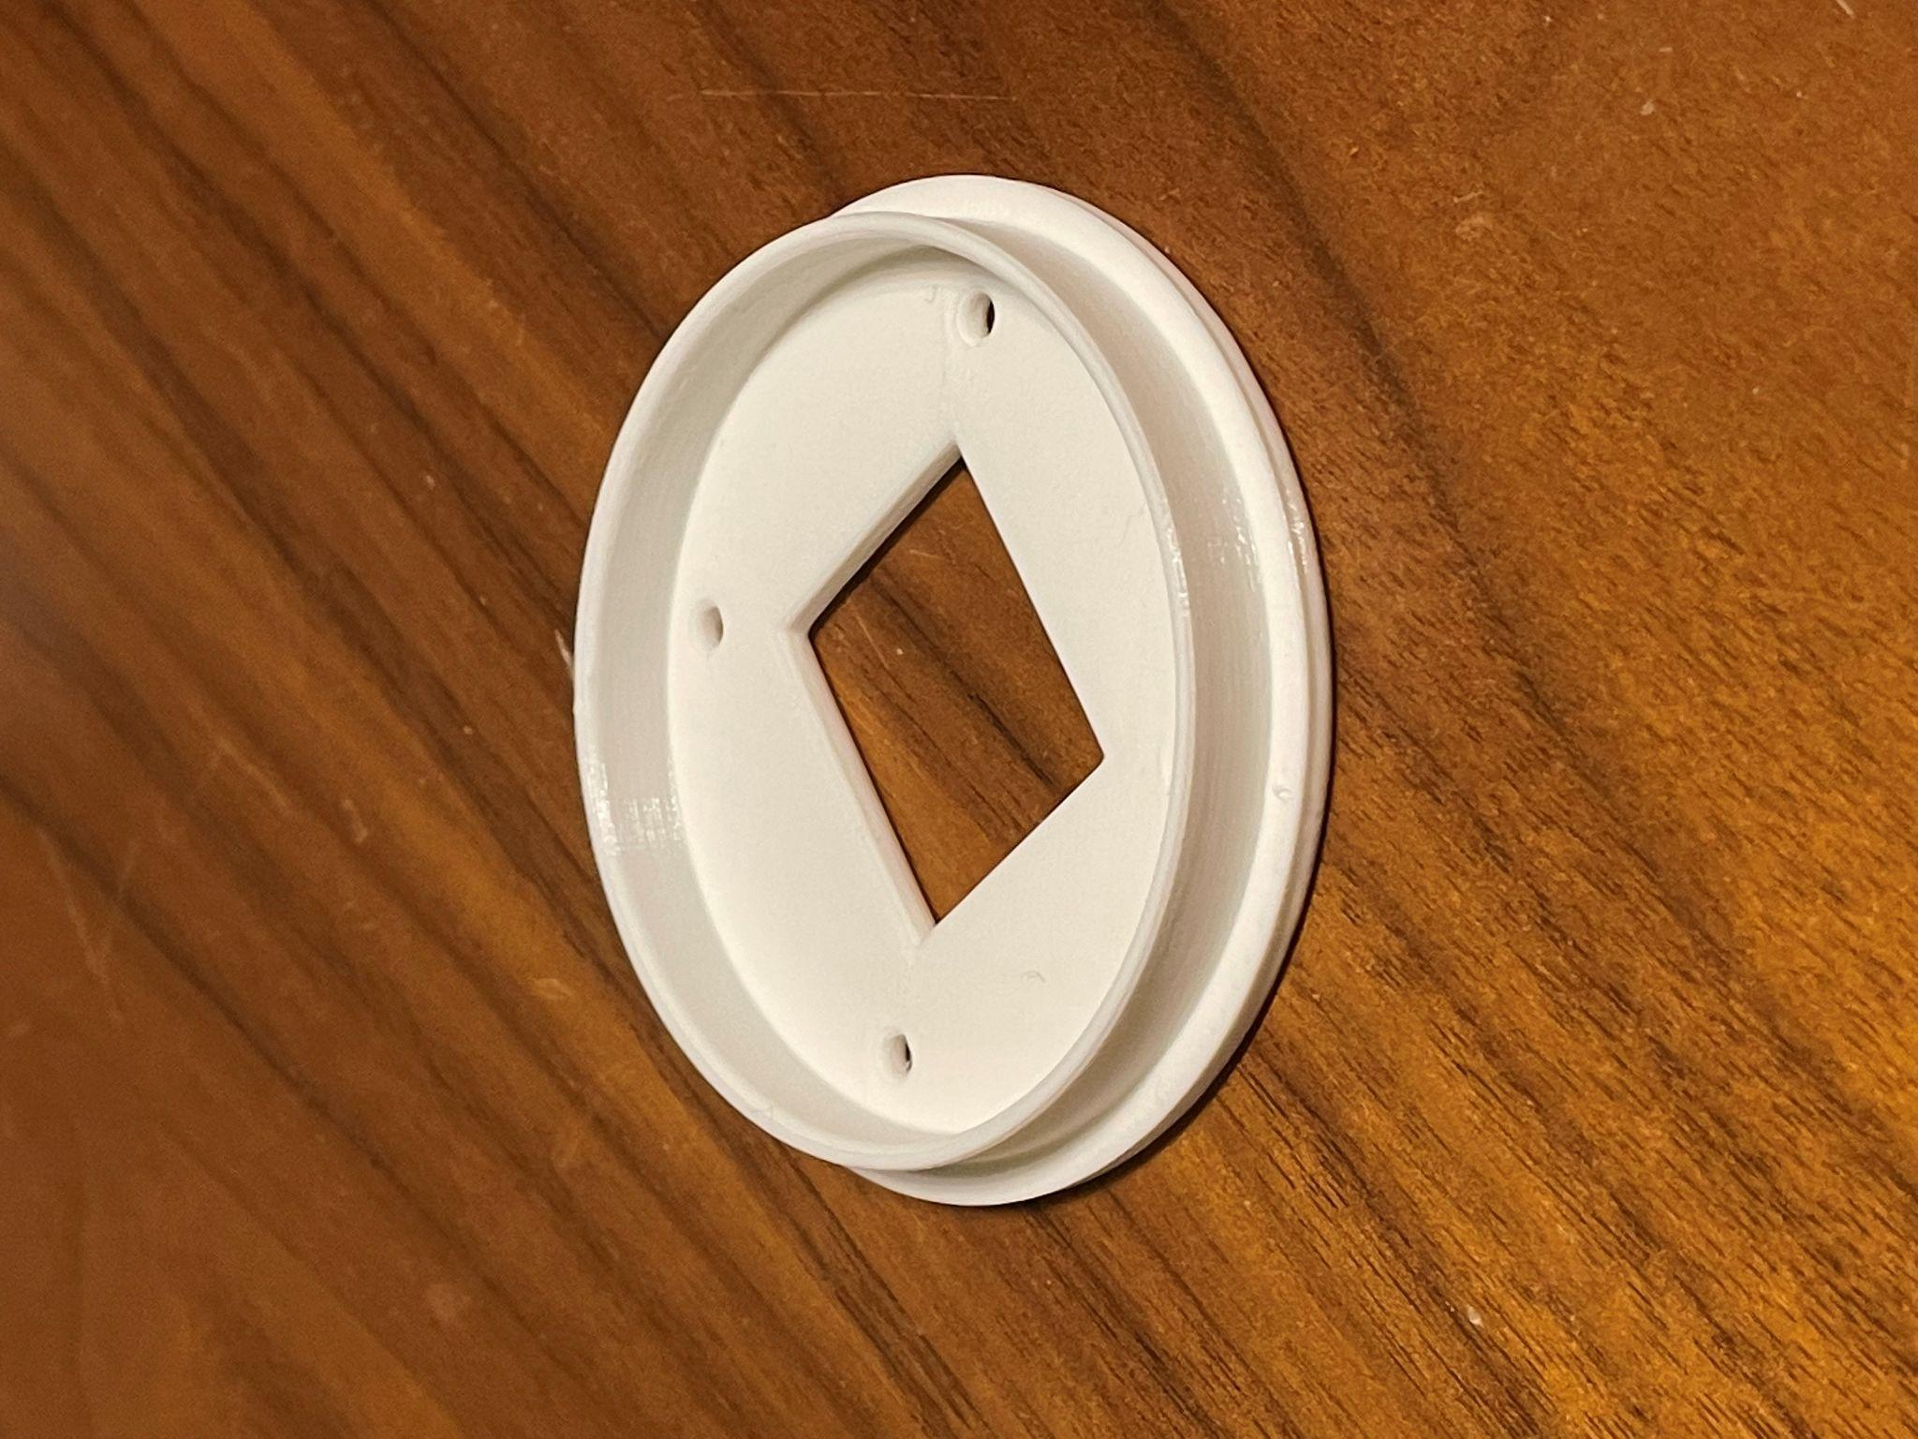
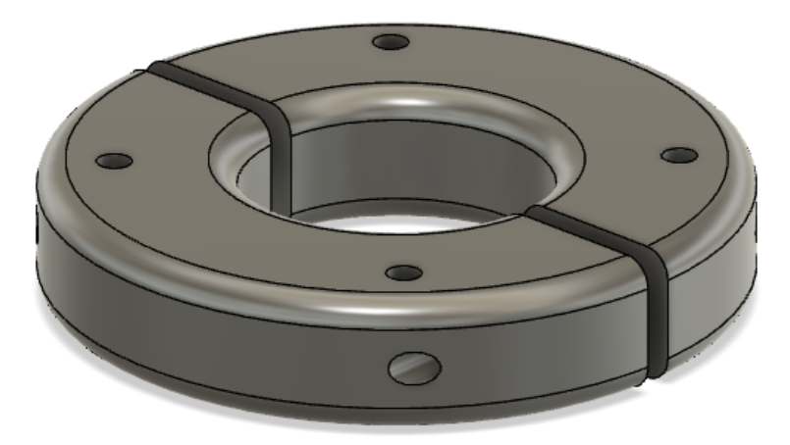
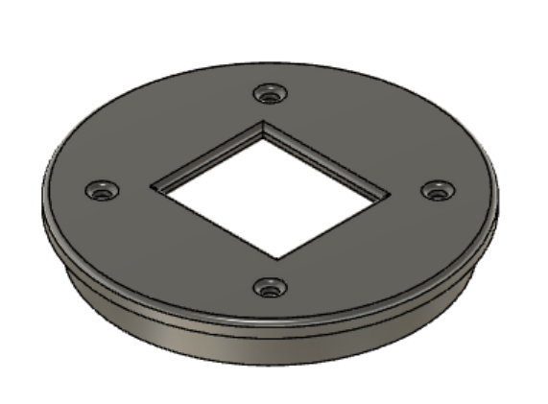
Imager Accomplishments
1st Model
2nd Model

Slide 9
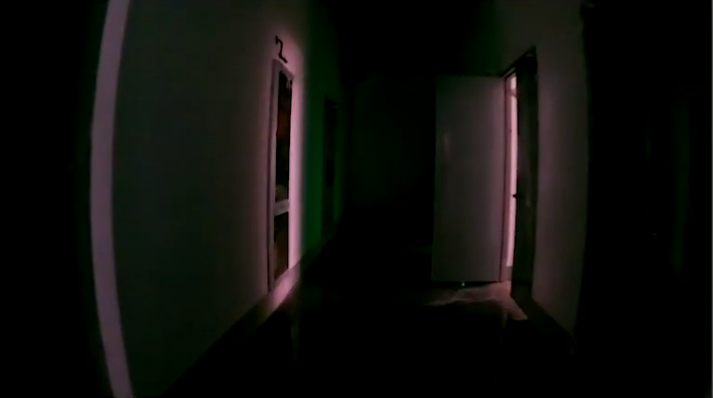
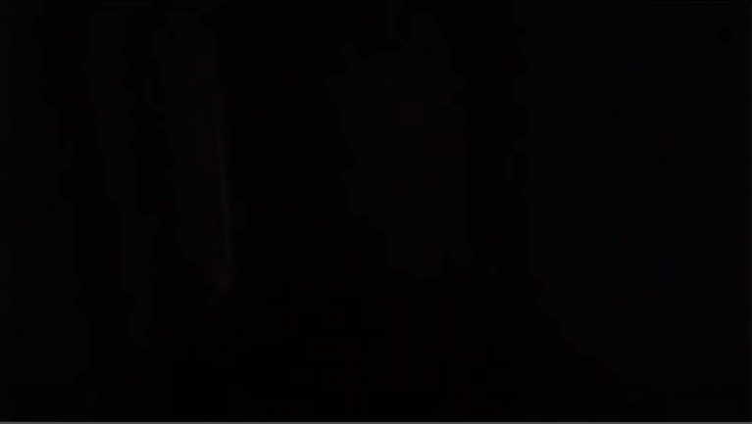
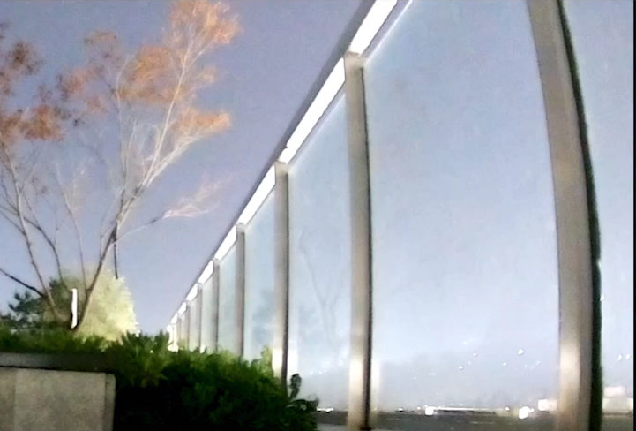
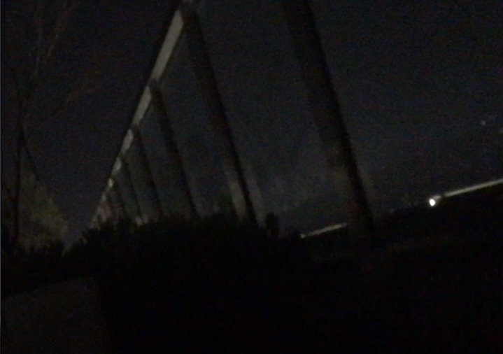
Imager Results
Arducam
IPhone

Slide 10



Aesthetics
Base Mount
Cover Mount
Cover Engraving

Slide 11
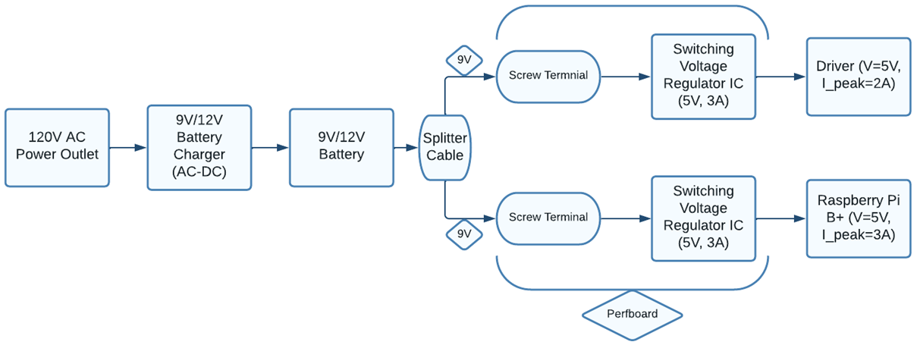
Power Supply Overview
Major Goals:
Provide regulated power to the driver and Raspberry Pi B+
Allow for recharging to take place whether or not the system is currently operating

Slide 12
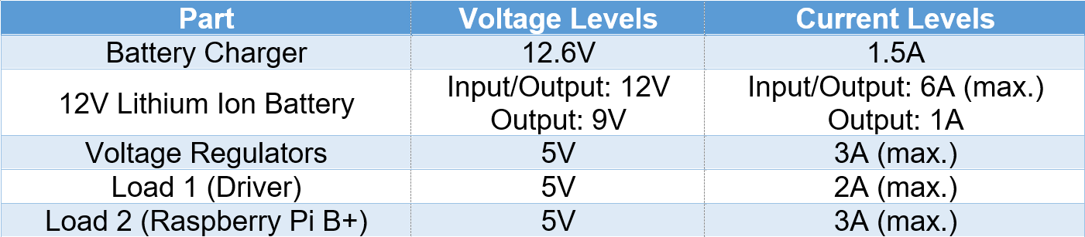
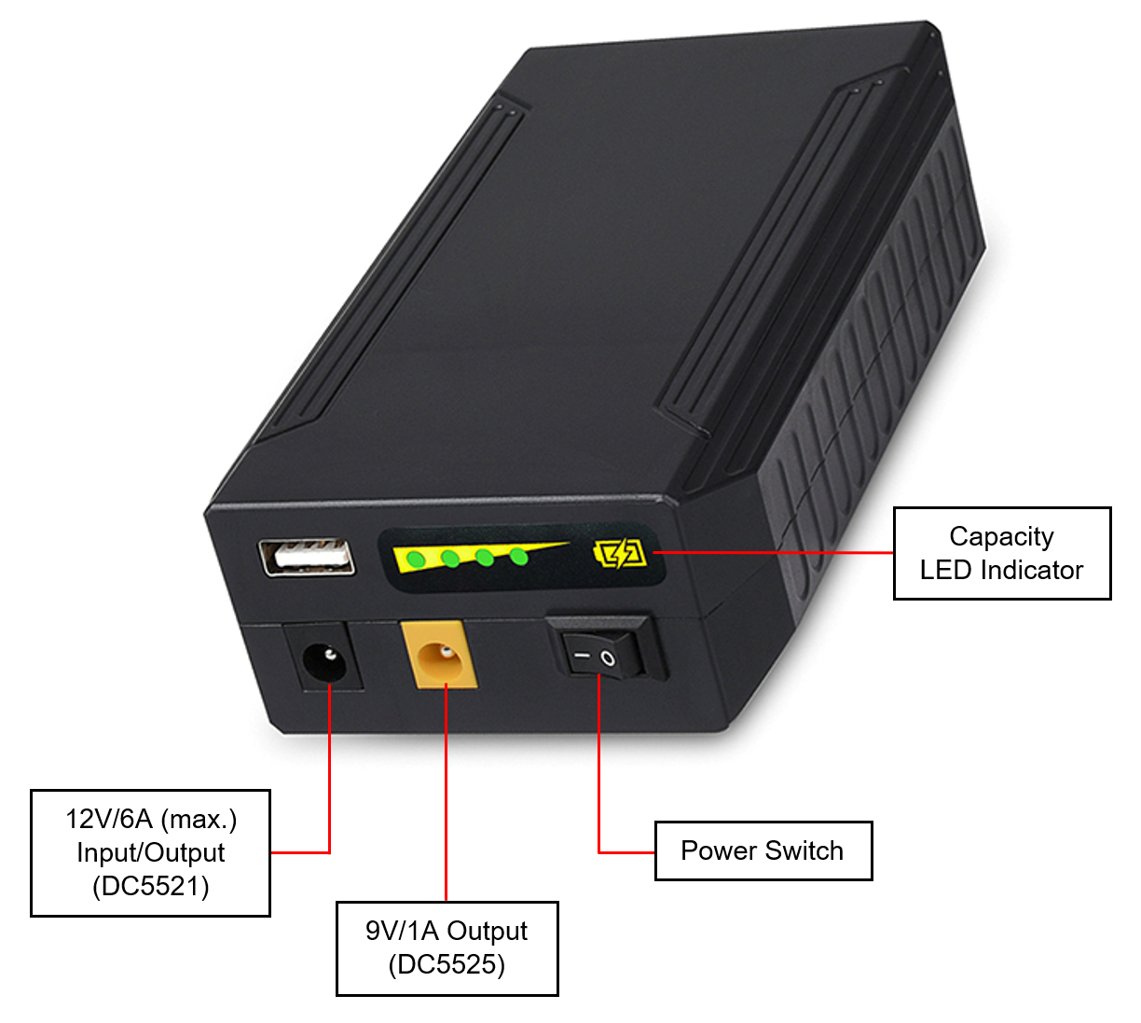
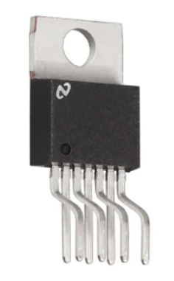
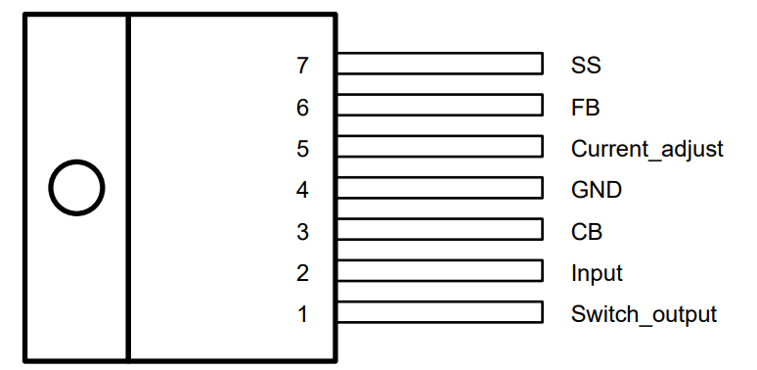
Power Supply Specifications
LM2673 SIMPLE SWITCHER 3-A Step-Down Voltage Regulator With Adjustable Current Limit

Slide 13
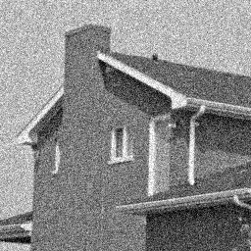
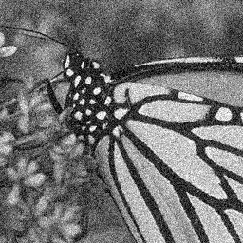
Image Processing & Autofocusing Program

Slide 14
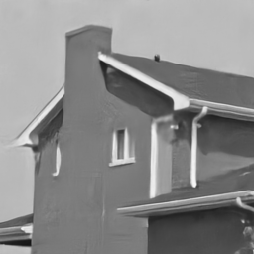
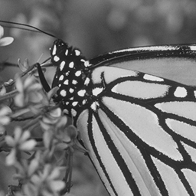


Image Processing & Autofocusing Program
Gaussian Denoising: DnCNN
https://github.com/cszn/DnCNN
Notes:
https://github.com/cszn/DnCNN

Slide 15
Image Processing & Autofocusing Program
Gaussian Denoising: DnCNN
Denoised
Ground Truth
https://github.com/cszn/DnCNN
Notes:
https://github.com/cszn/DnCNN

Slide 16
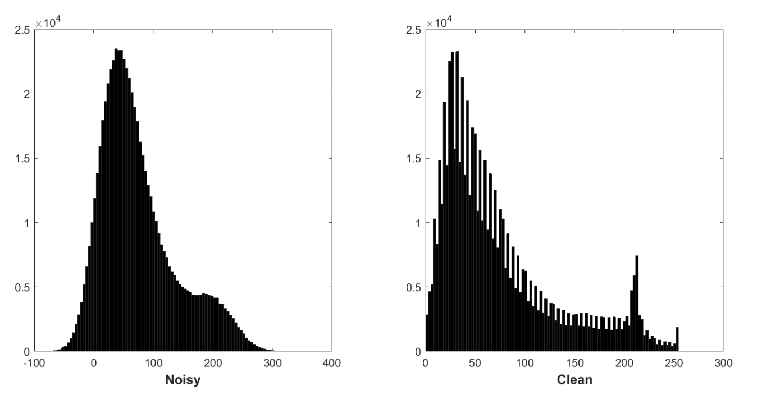
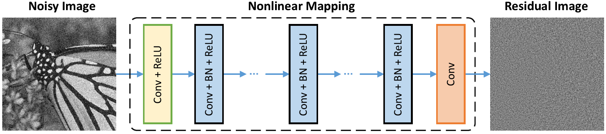
Image Processing & Autofocusing Program
Noisy image residual corrupted by AWGN
Follows a constant Gaussian distribution
Stabilizes batch normalization during training
Predicting the residual
Performing one gradient descent stepping]
Noise Level of 50 PSNR (db)
Approximately 26.23
https://github.com/cszn/DnCNN
Notes:
AWGN - Additive White Gaussian Noise
PSNR - peak signal-to-noise ratio

Slide 17
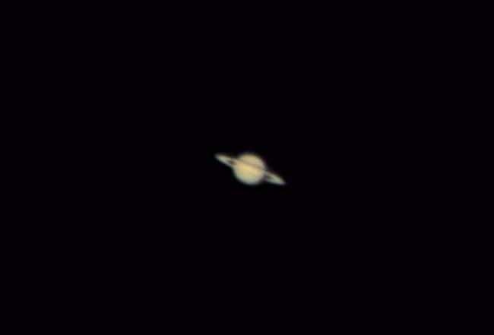

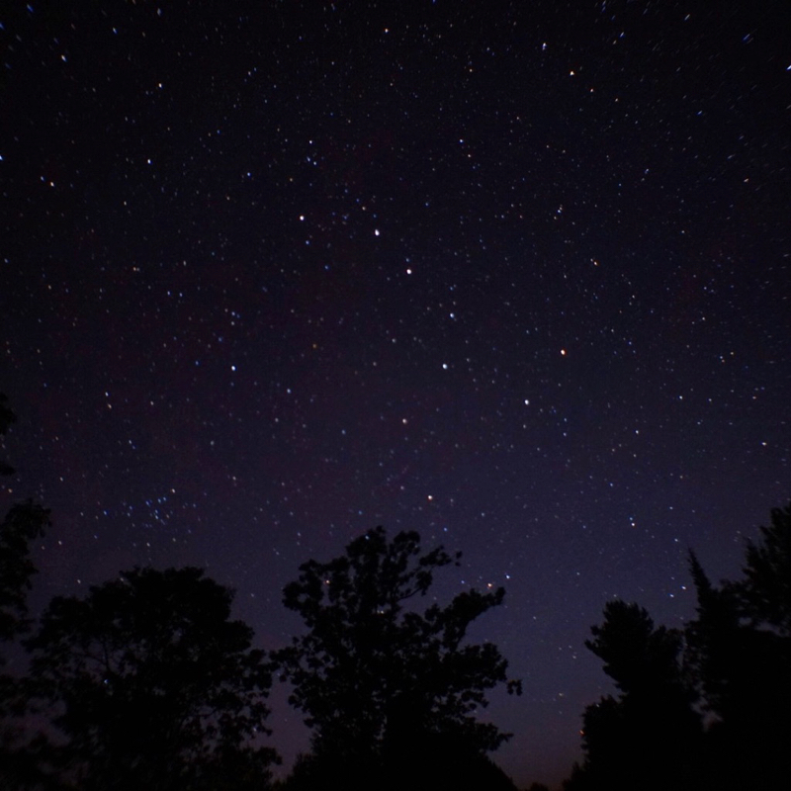

Image Processing & Autofocusing Program
Denoised+Opt
Ground Truth

Slide 18
Execution Plan
Subsystem | Timeline
Dev Board/Programming Machine Learning Optimization Statistical Image Optimization Stepper-motor Interface Q/A Testing | 2/24/22 - 3/12/22 3/13/22 - 3/30/22 3/31/22 - 4/15/22 4/16/22 - 4/23/22
Power Supply Design Charging-Battery Interface Design Redundancy System Charging-Battery Assembly Q/A Testing | 2/24/22 - 3/16/22 3/17/22 - 4/6/22 4/7/22 - 4/15/22 4/16/22 - 4/23/22
Motors Design Motor Mounts (CAD) 3D Print Motor Mounts Design Stepper Motor PWM interface Q/A Testing | 2/24/22 - 3/16/22 3/17/22 - 3/18/22 3/19/22 - 4/8/22 4/9/22 - 4/16/22
Imaging Design Imager Mount (CAD) 3D Print Imager Mount Image transmit to dev board Q/A Testing | 2/24/22 - 3/16/22 3/17/22 - 3/18/22 3/19/22 - 4/9/22 4/10/22 - 4/17/22

Slide 19
Validation Plan
Subsystem | Criteria
Dev Board/Programming Machine Learning Optimization Statistical Image Optimization Stepper-motor Interface | Algorithm sorts images and chooses most focused? Is performance increased by stacking more than 10 images? Can interface move stepper motor interface by a specific margin?
Power Supply Design Charging-Battery Interface Design Redundancy System Implement Power Circuit Charging-Battery Assembly | Is voltage at max after charging battery? Does each component receive operational values without damaging system components? Does each component receive operational values without damaging system components? Does measurements assembly fit within constraints of the telescope?
Notes:
Q/A Testing is expected for each section and will support the quality of work produced this semester leading in the next.

Slide 20
Validation Plan
Subsystem | Criteria
Motors Design Motor Mounts (CAD) 3D Print Motor Mounts Design Stepper Motor PWM interface Motor Quality | Do dimensions operate within the constraints of the telescope? Are parts the same dimensions as designed? Does motor operate on specific speeds and positions? Does motor operate without damaging the motor mount and assembly subsystem?
Imaging Design Imager Mount (CAD) 3D Print Imager Mount Image Quality Design I/O Data Streaming Interface | Do dimensions operate within the constraints of the telescope? Are parts the same dimensions as designed? Does image fit desired image specifications (resolution, pixel width) Can imager receive an image and transmit to Raspberry Pi
Notes:
Q/A Testing is expected for each section and will support the quality of work produced this semester leading in the next.

Slide 21
Remaining Tasks
Motor Assembly | Software validation
Image Processing | Finish designing the GUI
Power Supply | Assemble designed circuit on perfboard
Imager Assembly | Fasten final model with previous existing bolts

Slide 22
ECEN 404 Goals
Motor Assembly | Interface stepper to GUI backend interactions Dampened step modulations
Image Processing | Integrate a GUI that will display processed images Random client assessment
Power Supply | Design PCB board that will replace ICs
Imager Assembly | Obtain planetary images via the Newtonian telescope Implement telescope mounting across all subsystems

Slide 23
Q/A

